Slide 1

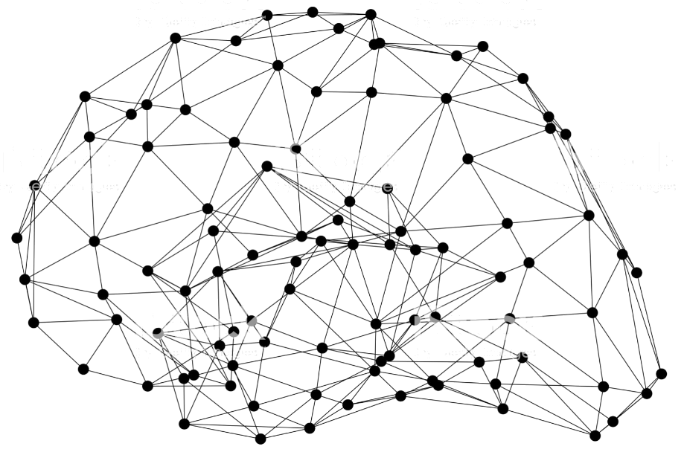
GluonCV: Video Action Recognition

Slide 2
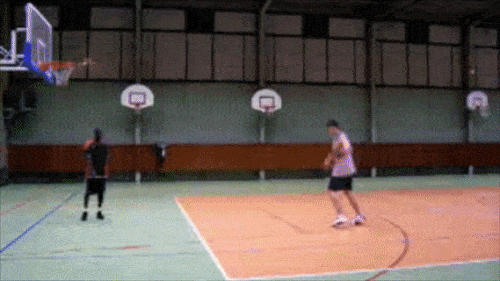
What’s video action recognition?
Recognize what action is the person doing in a video

Slide 3
Why video action recognition?
Classification problem (with temporal dimension), serves as basis for various video tasks, such as video object detection, video event localization, video retrieval, video recommendation, etc.
Useful applications, such as surveillance monitoring, robotics, gaming, human motion analysis, etc.

Slide 4
Popular models and datasets
Two-stream networks
TSN (temporal segment networks)
C3D
P3D
I3D
S3D
R(2+1)D
Non-local neural networks
TRN (temporal relation networks)
SlowFast
TSM (temporal shift module)
UCF101
HMDB51
Sports1M
ActivityNet
Charades
Kinetics400/600/700
Moments in time
HACS
Something-something-v1/v2

Slide 5
Popular models and datasets (what we have)
Two-stream networks
TSN (temporal segment networks)
C3D
P3D
I3D
S3D
R(2+1)D
Non-local neural networks
TRN (temporal relation networks)
SlowFast
TSM (temporal shift module)
SCSampler
UCF101
HMDB51
Sports1M
ActivityNet
Charades
Kinetics400/600/700
Moments in time
HACS
Something-something-v1/v2

Slide 6
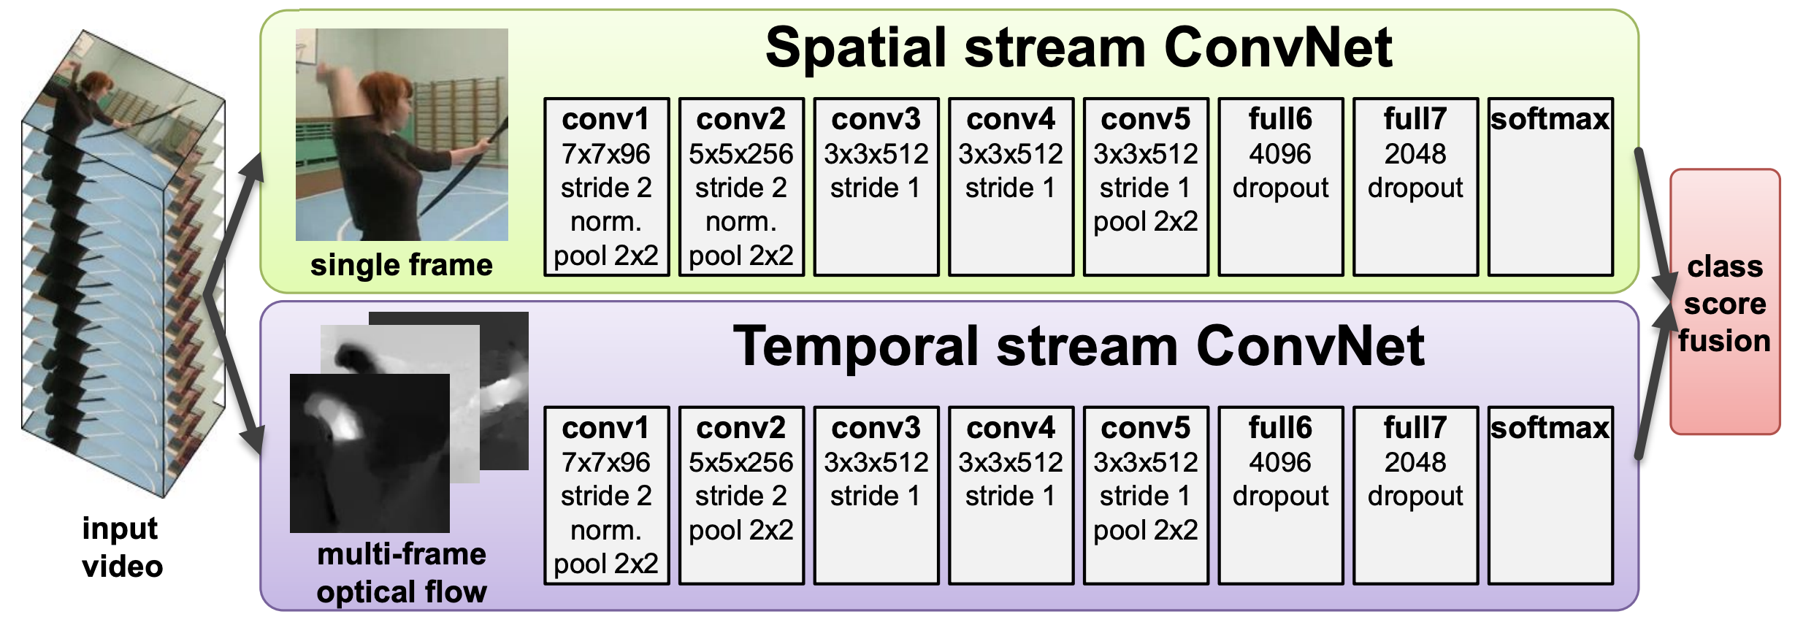
Two Stream Networks
Use optical flow to introduce temporal information
Karen Simonyan and Andrew Zisserman, Two-Stream Convolutional Networks for Action Recognition in Videos, NeurIPS 2014

Slide 7
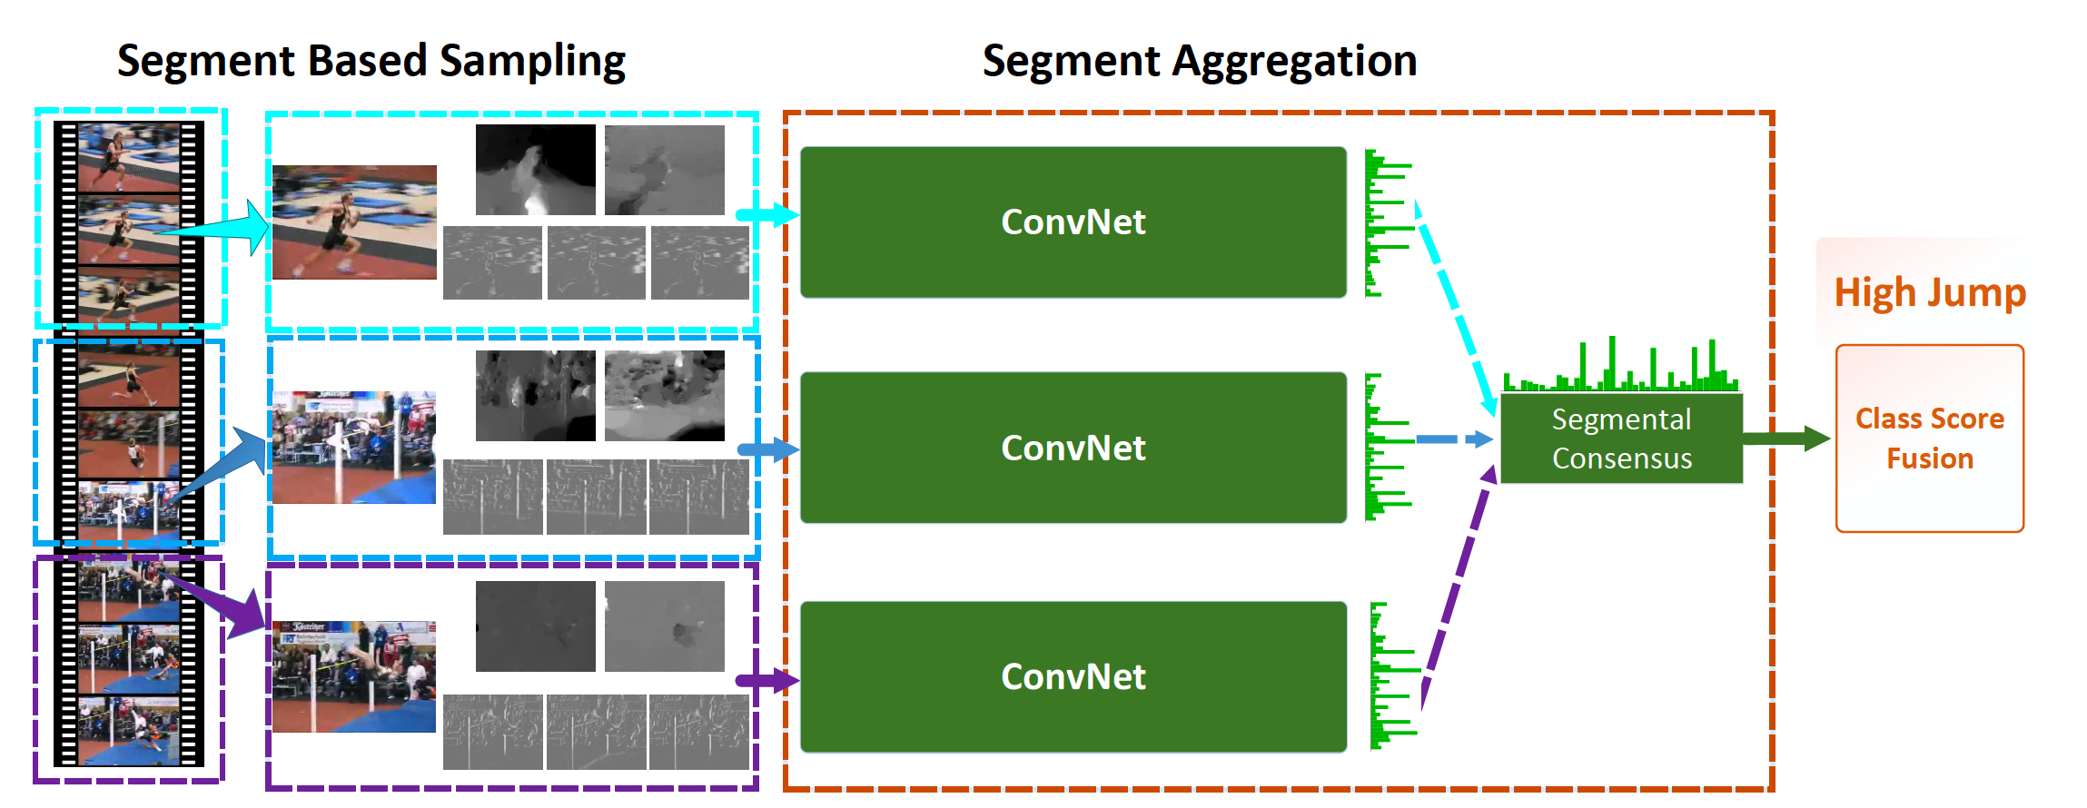
Temporal Segment Networks
Introduce segments to reason longer temporal context
Limin Wang, et al., Temporal Segment Networks: Towards Good Practices for Deep Action Recognition, ECCV 2016

Slide 8
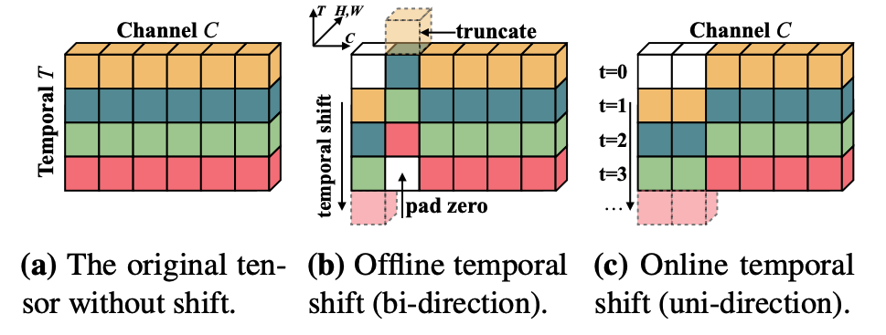
Temporal Shift Module
Use shift to mimic 3D conv, improve accuracy at no extra computation and parameters.
Ji Lin, et al., TSM: Temporal Shift Module for Efficient Video Understanding, ICCV 2019

Slide 9
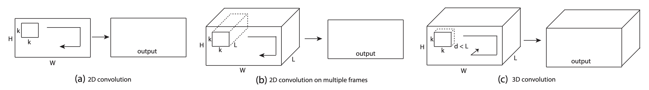
C3D
Use 3D convolution network to learn spatiotemporal features for video applications
Du Tran, et al., Learning Spatiotemporal Features with 3D Convolutional Networks, ICCV 2015

Slide 10
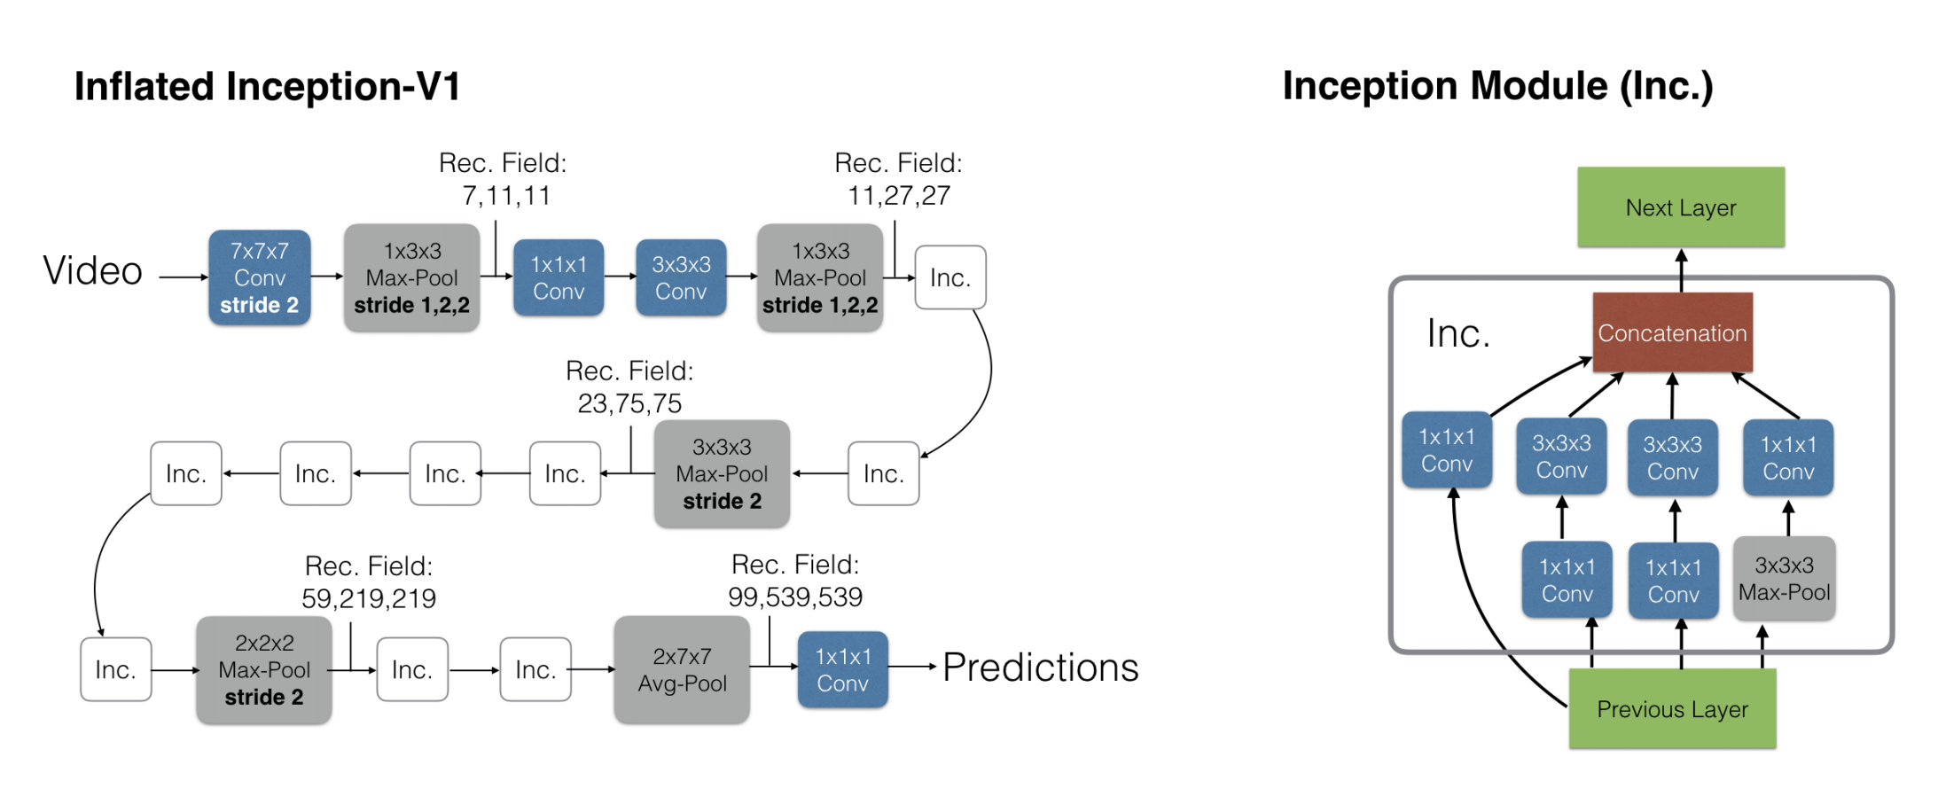
I3D
Inflating 2D CNNs to 3D, and bootstrapping 3D filters from 2D filters
Joao Carreira and Andrew Zisserman., Quo Vadis, Action Recognition? A New Model and the Kinetics Dataset, CVPR 2017

Slide 11
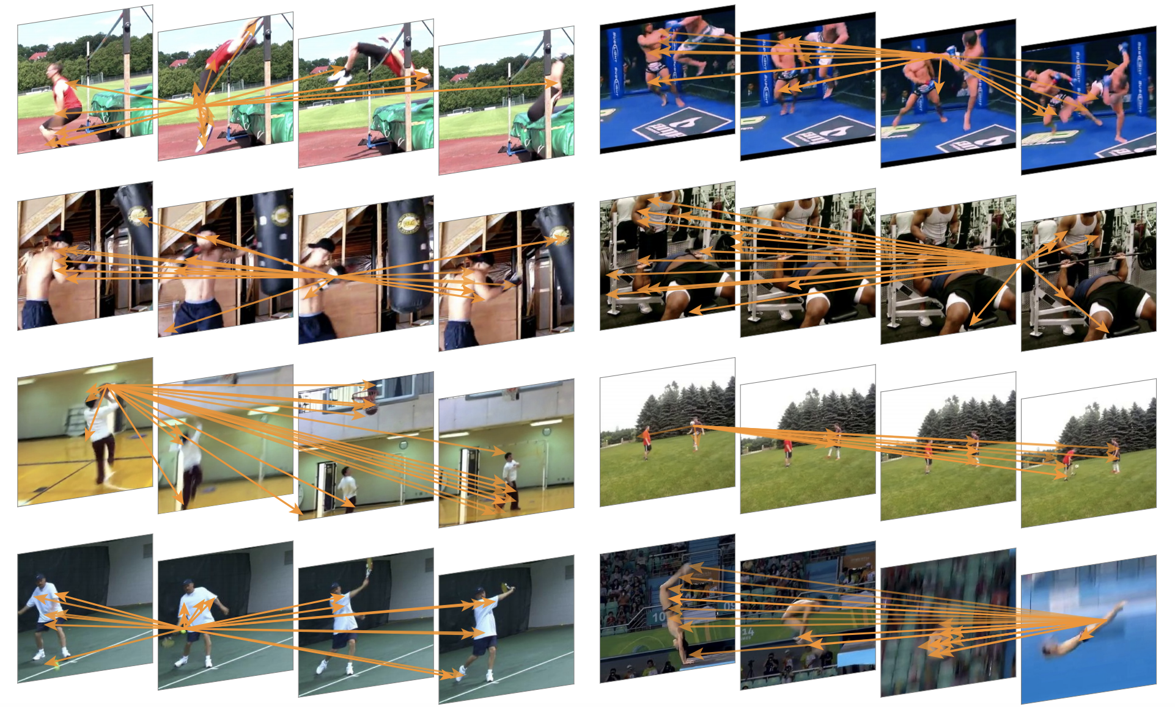
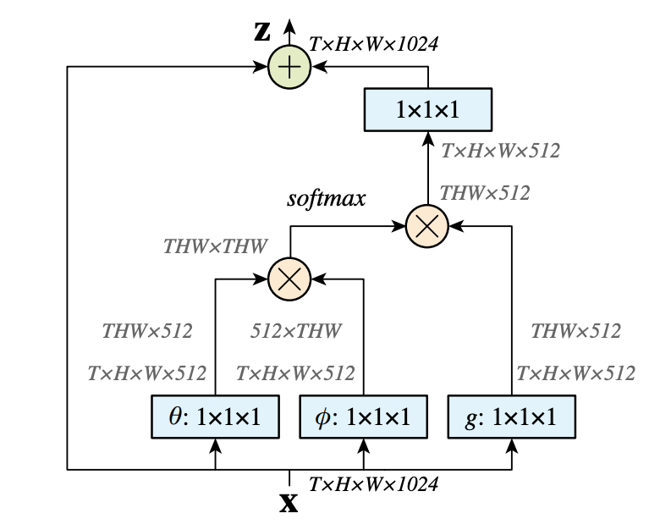
Non-local Neural Networks
Introduce non-local (self-attention) block to capture long-range temporal dependencies.
Xiaolong Wang et al., Non-local Neural Networks, CVPR 2018

Slide 12
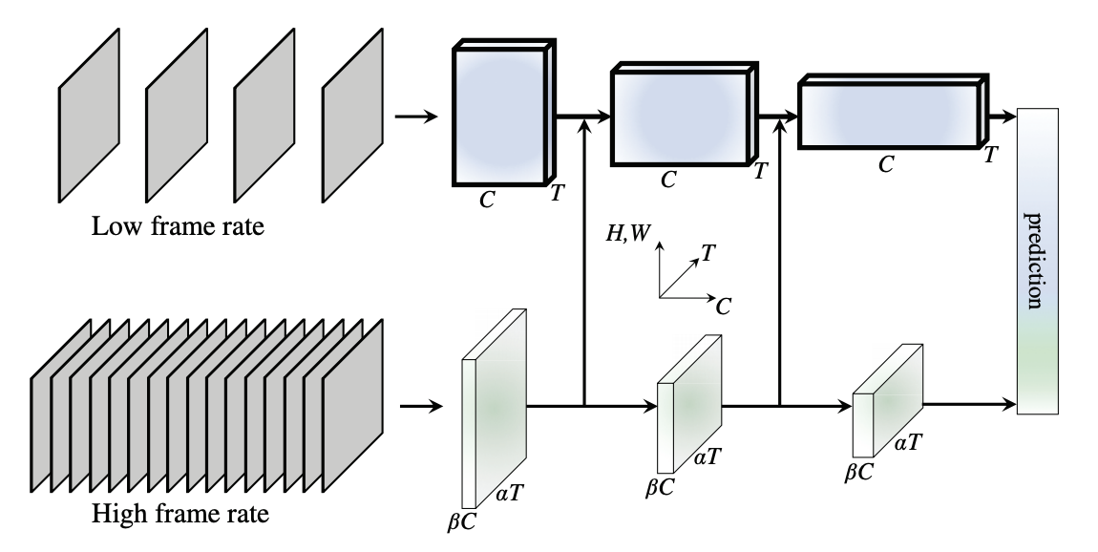
SlowFast
Two branch, slow and fast, to handle video classification with less computation
Christoph Feichtenhofer et al. SlowFast Networks for Video Recognition, ICCV 2019

Slide 13
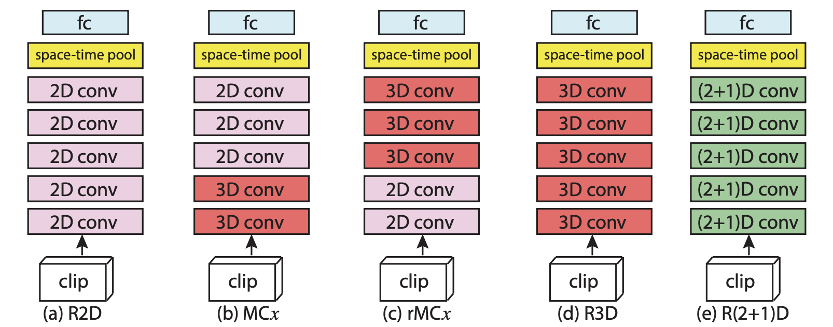
R2+1D
Explore various mixed architectures for efficient video modeling
Du Tran et al., A Closer Look at Spatiotemporal Convolutions for Action Recognition, CVPR 2018

Slide 14
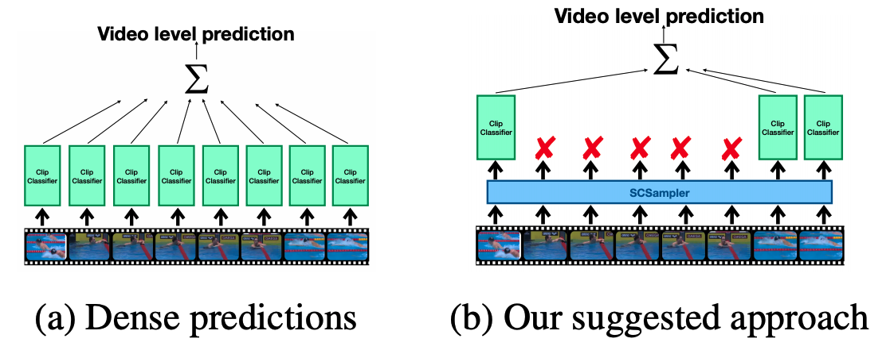
SCSampler
Simple idea, select salient clips for evaluation
Bruno Korbar et al., SCSampler: Sampling Salient Clips from Video for Efficient Action Recognition, ICCV 2019

Slide 15
Implement SOTA Video Action Recognition Models with GluonCV
Method | Metric | GluonCV | Reference
TSN-VGG16 | Top-1 acc on UCF101 | 83.4% | 82.8 (TSN)
TSN-InceptionV3 | Top-1 acc on Kinetics400 | 72.5% | 72.5% (TSN)
I3D-InceptionV1 | Top-1 acc on Kinetics400 | 71.7% | 71.1% (paper)
I3D-ResNet50 | Top-1 acc on Kinetics400 | 73.6% | 72.9% (MMAction)
I3D-NL-ResNet101 | Top-1 acc on Kinetics400 | 76.1% | 76.0% (paper)
SlowFast-4x16-ResNet50 | Top-1 acc on Kinetics400 | 75.7% | 75.6 (paper)
TSN-ResNet50 | Top-1 acc on something-something-v2 | 35.5% | 30.0% (paper)
SOTA pre-trained models (RGB input)

Slide 16
Implement SOTA Video Action Recognition Models with GluonCV
Data API
Automated data preparation
Dataset
Image/Video dataloader
Transformation API
Metric API
Loss API
Pre-defined network architectures
Building-blocks
Custom Layers
Reproducible Experiments
Training Script
Configurations
Available in GluonCV

Slide 17
Fast Data Loading
Our frame-based data loader is 1.3x faster than mmaction toolkit (https://github.com/open-mmlab/mmaction)
We also support loading videos directly during training. Our video loader (decord: https://github.com/zhreshold/decord) is 6 times faster than OpenCV “cv2.VideoCapture”.
Our code support distributed training across multiple machines.

Slide 18
Why Use GluonCV Video Toolkit?
Compared to existing open source toolkits for video classification (MMAction, PyVideoResearch, TorchVision 0.4 Video),
Our model zoo coverage is more complete (2D, 3D, 2+1D networks)
Fully reproducible results with training recipe and training logs
Faster data loading for quick experiment iteration
Detailed documentation and tutorials to get you started (feature extraction, fine-tuning, etc.)
We support more datasets
Unified train/test script, easy to understand and modify
Actively maintained

Slide 19
Hands On!

Slide 20

Like GluonCV? Go build!
https://github.com/dmlc/gluon-cv
https://gluon-cv.mxnet.io

